Slide 1
The Brief
Single player game
A genre of game that has a typical mechanic or set of mechanics
Develop a game without the typical mechanic or mechanic set
Develop a refined new solution to the problem that removing the mechanic creates.
Emphasise a single mechanic

Slide 2
Our Solution
Removing the shooting mechanic from a shooting game
and replacing it with a redirection mechanic.
Our game is now a reflex and logic puzzle game.
Target audience Male 20-30

Slide 3
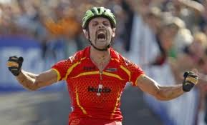

Intended Emotions
Challenged upon encountering a new puzzle.
Intrigue as a new mechanic is introduced.
Feeling smart upon figuring out the solution to a level.
Fiero, Relief and Accomplishment upon completing the puzzle.
Notes:
We’ve designed our game around Hard Fun. We intend to challenge our players by offering them new puzzles. We want them to feel smart for solving our puzzles, and feeling accomplished when finishing a level.

Slide 4



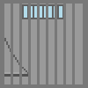

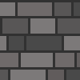
Core Game Loop
Redirect projectiles
Jump / Move
Try not to die
Notes:
The core game loop for our game will be to redirect projectiles of a shield the player will have using the right joystick as well as traversing the level with movement and jumping

Slide 5
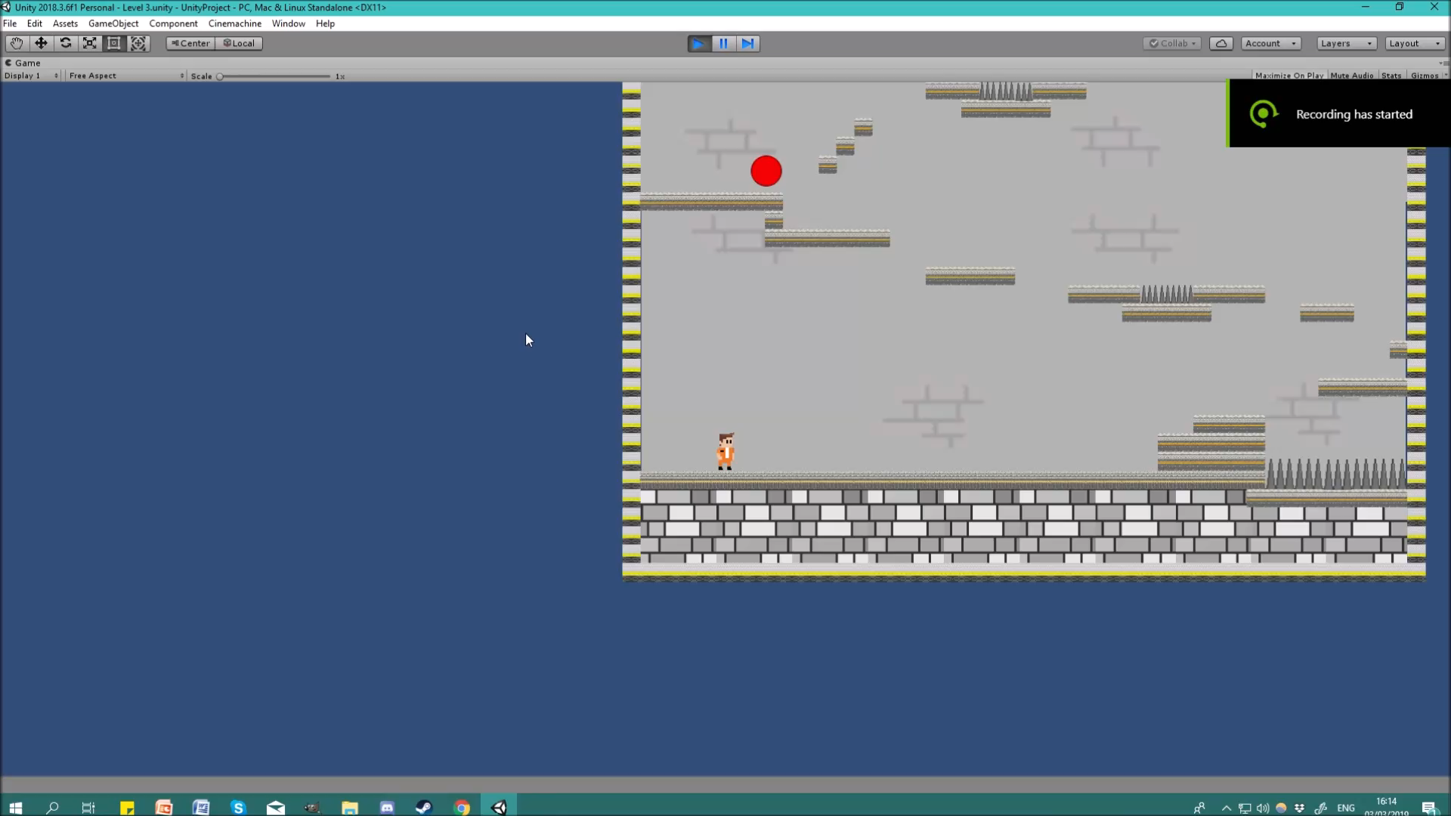
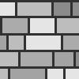



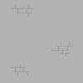
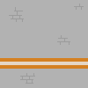
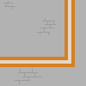
Character Art
https://youtu.be/x7EqNRKcSDo
Turret Art
Environmental Art
Notes:
B: We will now show you a video of our game and how it looks at the moment. As you can see the player currently has basic movement. This is controlled using the left joystick of a controller. The shield is this white box here and is controlled currently with the right joystick and rotated with the triggers. The player has the ability to reflect the turrets projectiles with the shield, in the future this will be used to reflect the bullets at buttons or other objects rather than being used to destroy the turrets themselves. The player has to make his way up to the top of the level to the door to proceed to either the next room or the next floor within the prison.
N: We made strong contrast between the orange player and the grey background, to keep the player’s character high on the visual hierarchy. We also designed levels around intuitive tutorials. We typically use the rule of three: we give the player a simple problem, a slightly more difficult version of that problem, and then that problem with a twist, in order to teach the player mechanics.

Slide 6
High Level Game Loop
Enter a new room see the exit door in relation to MC
Encounter and overcome the puzzles within the room
Leave the room
At the end of each floor destroy the previous floor and descend
Notes:
The high level game loop is going to be the player will enter a room and be able to see the exit door in relation to himself, this may be using a camera pan or zooming out at the start of the room if the room is too large.
The player will then encounter and overcome the puzzles within the room that need to be solved to proceed through the room.
When the player has done this he will leave the room and proceed to the next room or go to the floor below.
At the end of each floor which will be 3 rooms we will destroy the previous floor that the player was on and descend to the next floor.

Slide 7
Deliverable
3 floors with 3 rooms in each
Each floor will introduce a new enemy and projectile
Fluid shield movement (In order to better increase immersion)
Instant respawn (To reduce frustration)

Slide 8
Player Response
“The learning curve was just right, to me. As soon as I got used to a new puzzle type, a new one would be thrown in - and then the inevitable combination levels. I can't even imagine the amount of planning to just create each level. Well done!”

Slide 9
Questions?

Slide 10
Character Design
The main character will be a prisoner the age and gender of our target audience.
His outfit and colour palette were selected to immediately identify him as a prisoner and to have him stand out as lively and mobile contrasting the grey unfeeling prison.

Slide 11

Enemy Designs
The drone and turret were designed as an autonomous enemy that could be outsmarted and even used to traverse puzzles.
The grey is used to show they are machines and part of the prison but the purples and reds to show that they are active and functional. Purple specifically is used to show that they are unnaturally alive and unnerving.

Slide 12



